Slide 1
PLAYING MUSIC USING HAND GESTURES
PRESENTATION BY
TEAM-3 (SWECHA)

Slide 2
THANK U ONE & ALL
? Time..

Slide 3

1. OPENCV

Slide 4

2.Videocapture

Slide 5
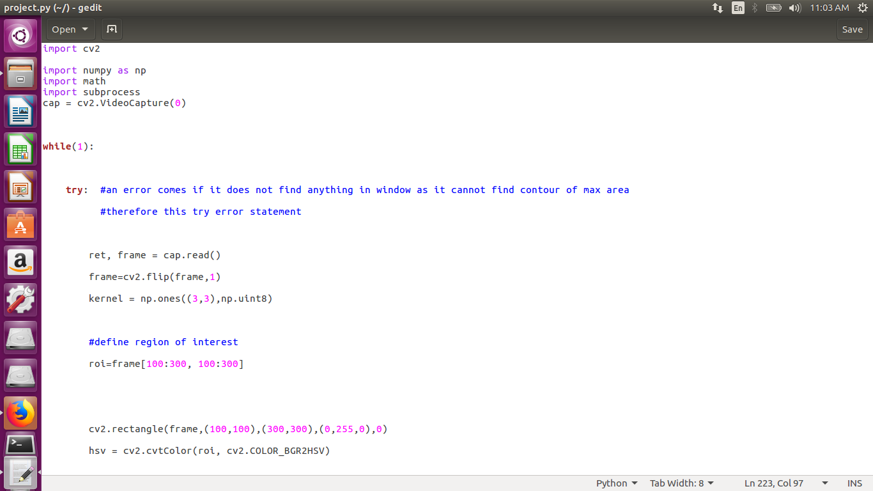

Slide 8
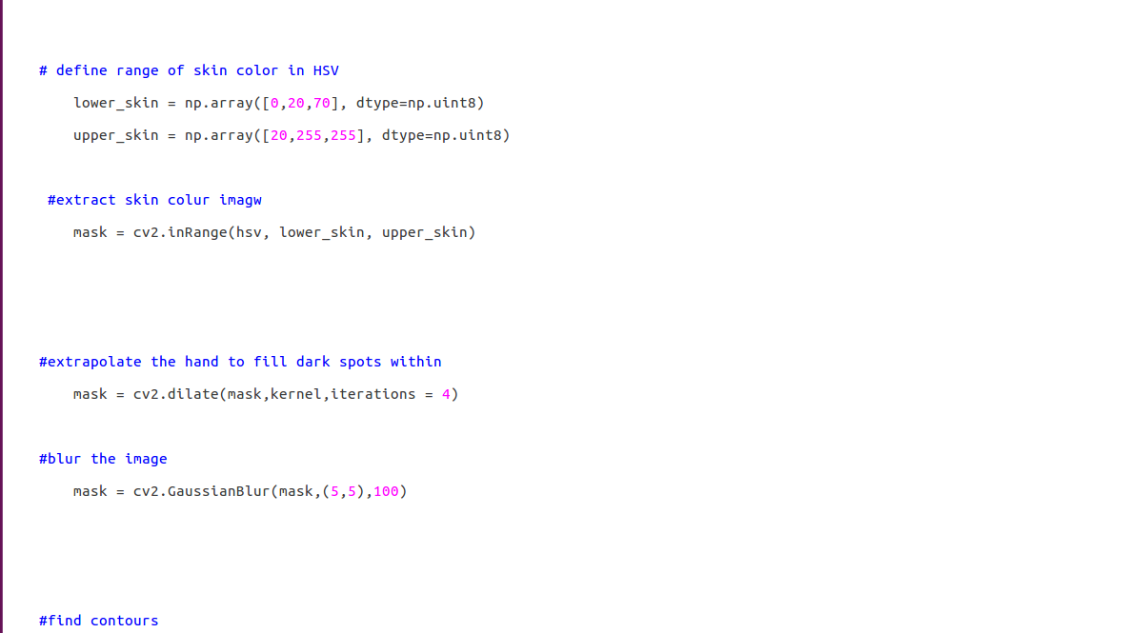

Slide 9
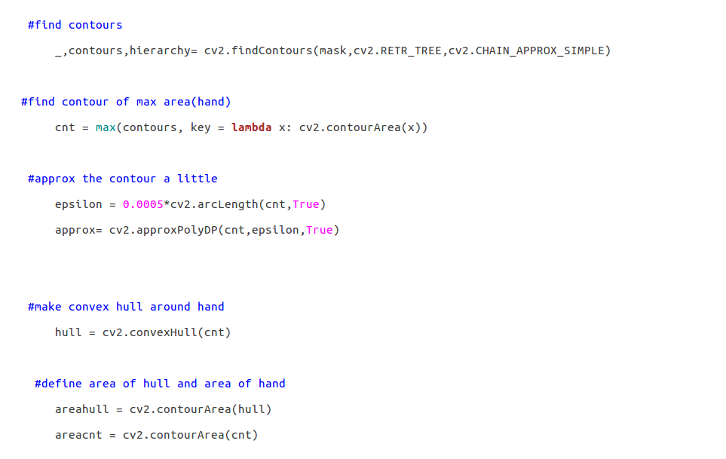

Slide 10
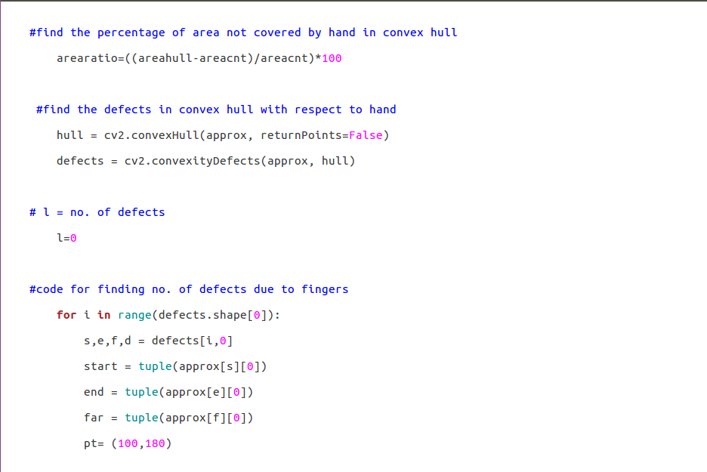

Slide 11
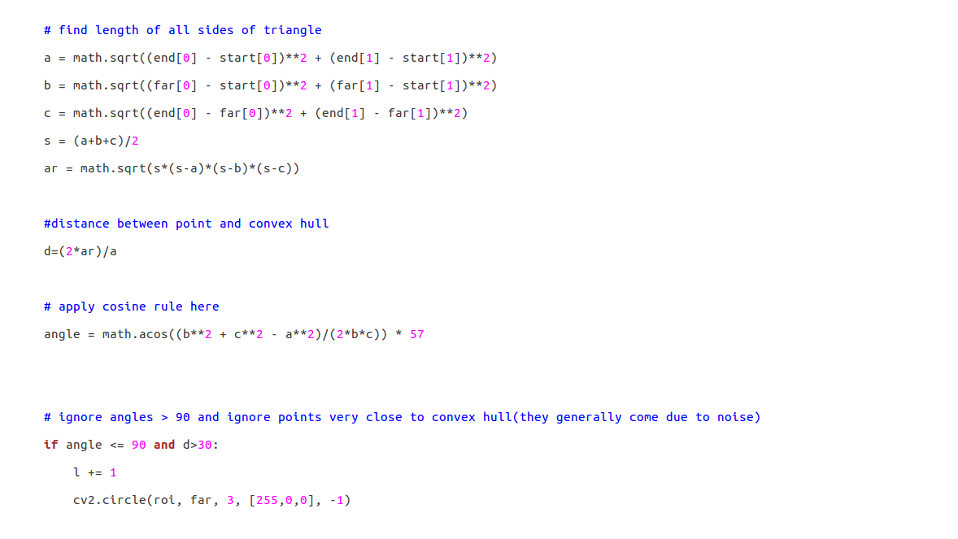

Slide 12
#draw lines around hand cv2.line(roi,start, end, [0,255,0], 2)

Slide 13
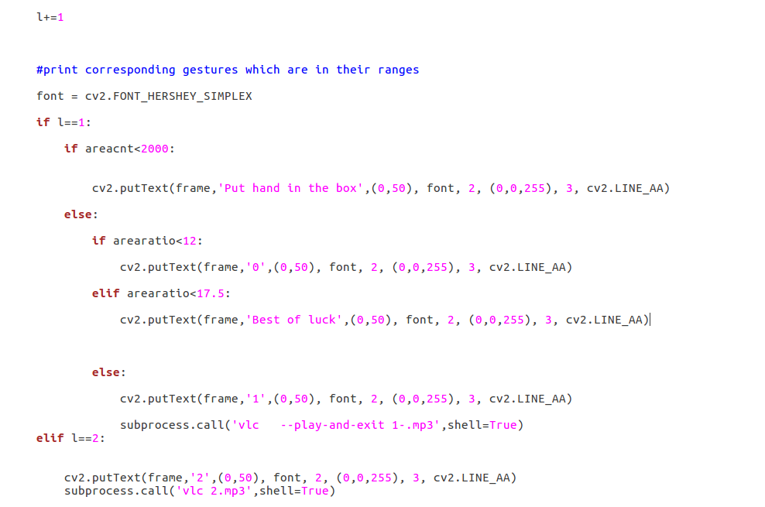

Slide 14
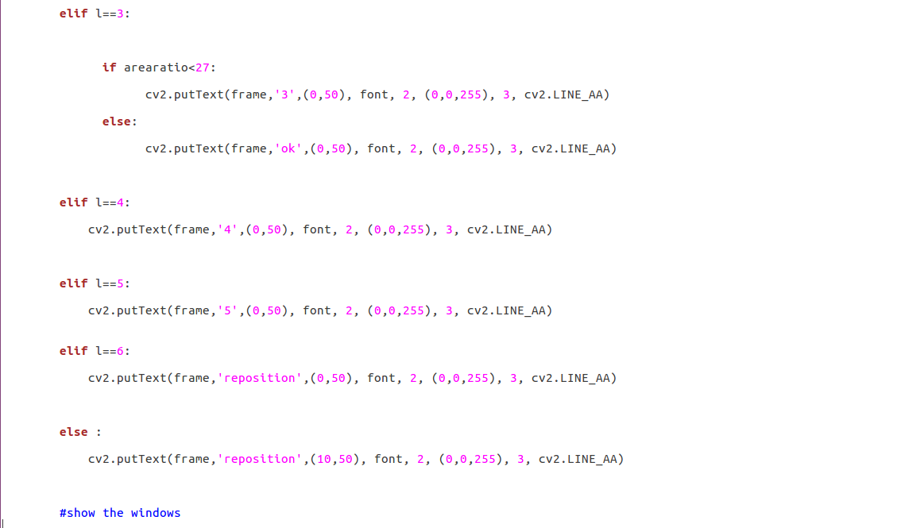

Slide 15
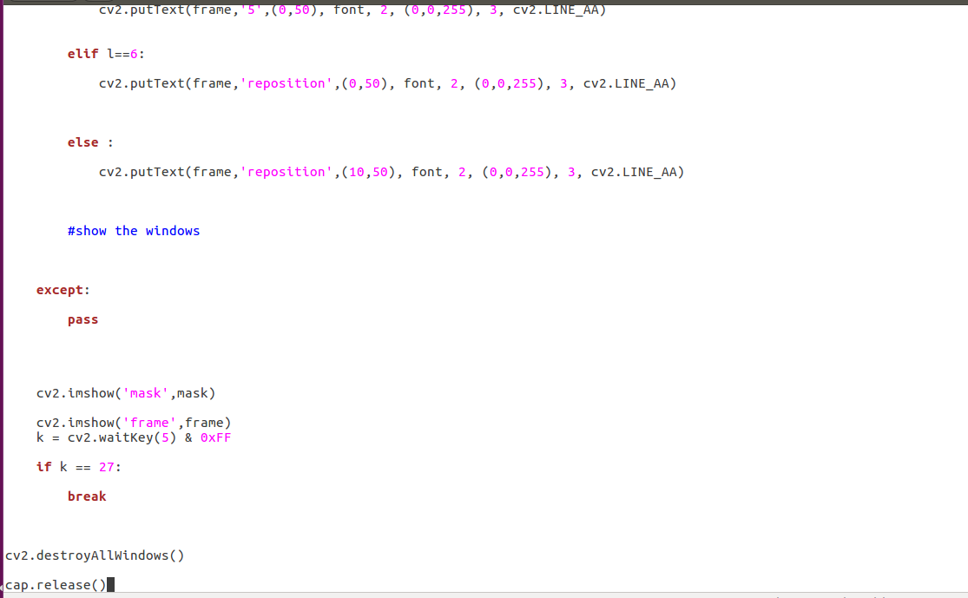

Slide 16

3.Math..

Slide 17
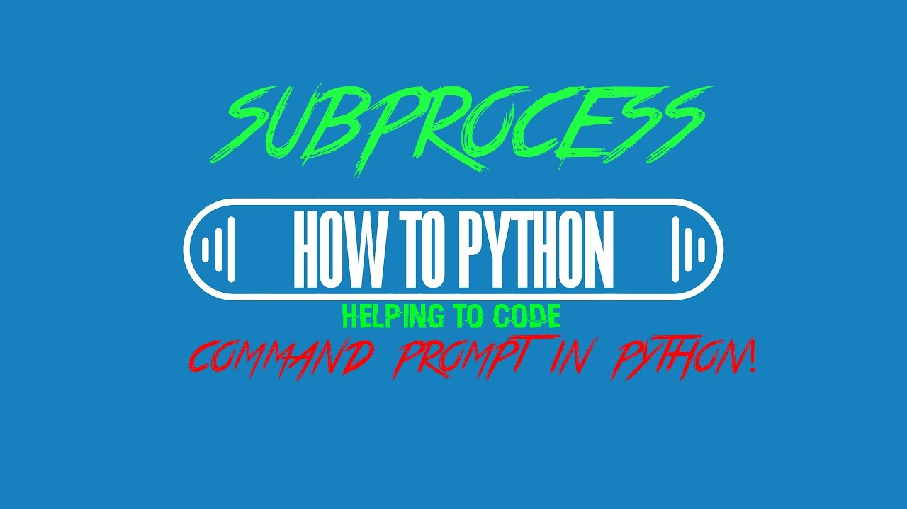
4. Subprocess

